Slide 1
What is computational imaging?
In contrast to traditional imaging, computational imaging systems involve a tight integration of the sensing system and the computation in order to form the images of interest.
The integration of the sensing and the computation in computational imaging systems allows for accessing information which was otherwise not possible.

Slide 2
BIOE580 Class Presentation
Refik Mert Cam
11/29/2021

Slide 3
Outline
Learned filtered backprojection method for use with half-time circular Radon transform data
Directional TV reconstruction algorithm for PACT
Dynamic reconstruction of three dimensional PACT from few projections

Slide 4
Learned filtered backprojection method for use with half-time circular Radon transform data

Slide 5
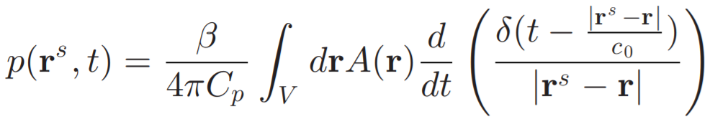
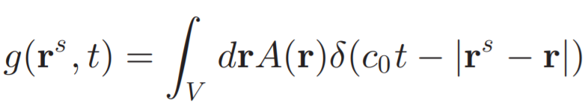
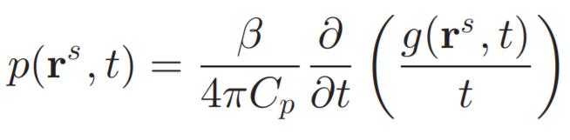
C-C Imaging model for PACT
More Convenient Expression of C-C Imaging model for PACT
Spherical Radon Transform
Spherical Radon transform appears in the physical modeling of wave-based medical imaging modalities such as photoacoustic computed tomography (PACT) and ultrasound reflectivity tomography.

Slide 6
Symmetry property of classical Radon transform

Slide 7
Data Redundancy in Complete CRT Data

Slide 8
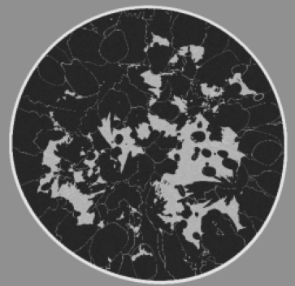
Learned Filtered Backprojection Method for use with Half-time Circular Radon Transform Data
MSE
Reconstruction
Filtering
Half-time CRT
Linear
UNet
Back-projection
MSE
Reconstruction
Half-time CRT
Back-projection
Nonlinear
UNet

Slide 9
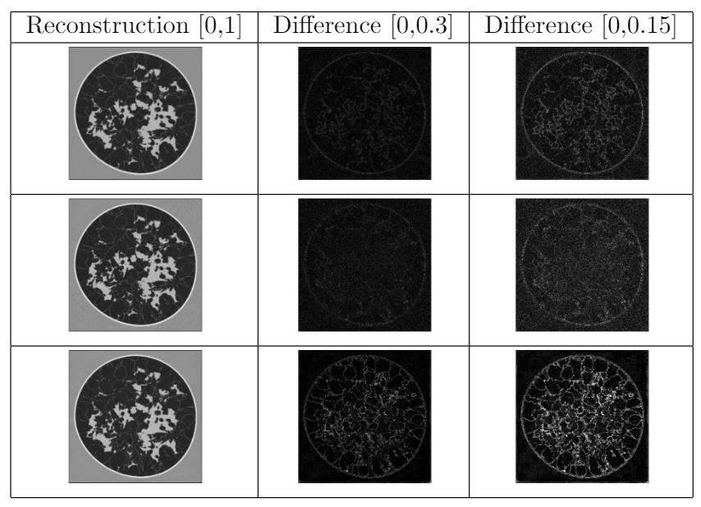
Learned Filtered Backprojection Method for use with Half-time Circular Radon Transform Data
Analytical full-time FBP reconstruction
Learned half-time FBP reconstruction
Post-processing UNet reconstruction

Slide 10
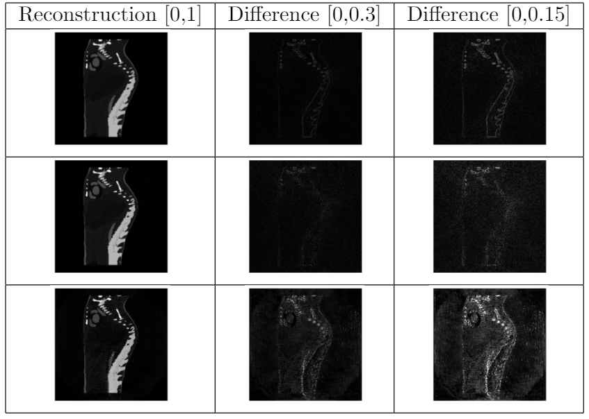
Learned Filtered Backprojection Method for use with Half-time Circular Radon Transform Data
Analytical full-time FBP reconstruction
Learned half-time FBP reconstruction
Post-processing UNet reconstruction

Slide 11
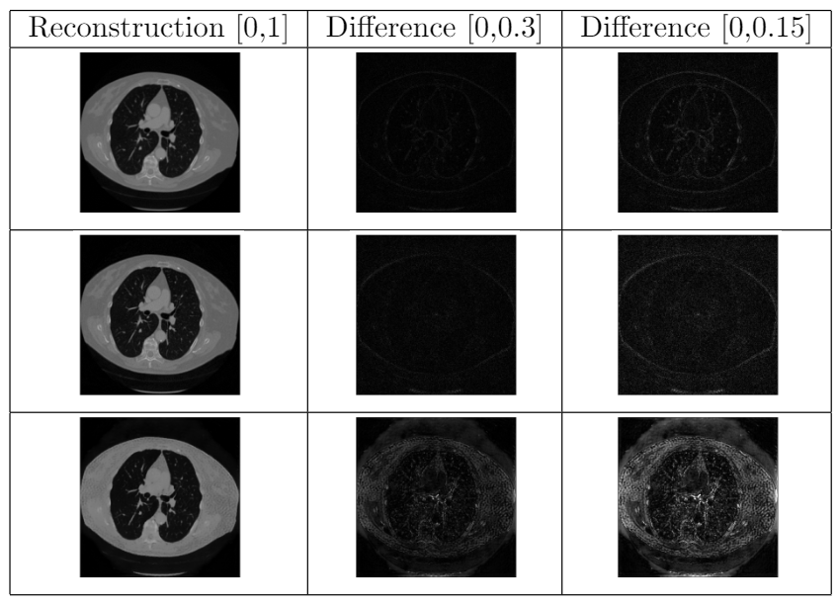
Learned Filtered Backprojection Method for use with Half-time Circular Radon Transform Data
Analytical full-time FBP reconstruction
Learned half-time FBP reconstruction
Post-processing UNet reconstruction

Slide 12
Directional TV reconstruction algorithm for PACT

Slide 13
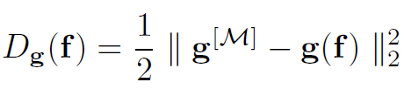
Directional TV reconstruction algorithm for PACT
ITV Reconstruction Algorithm
DTV Reconstruction Algorithm

Slide 14
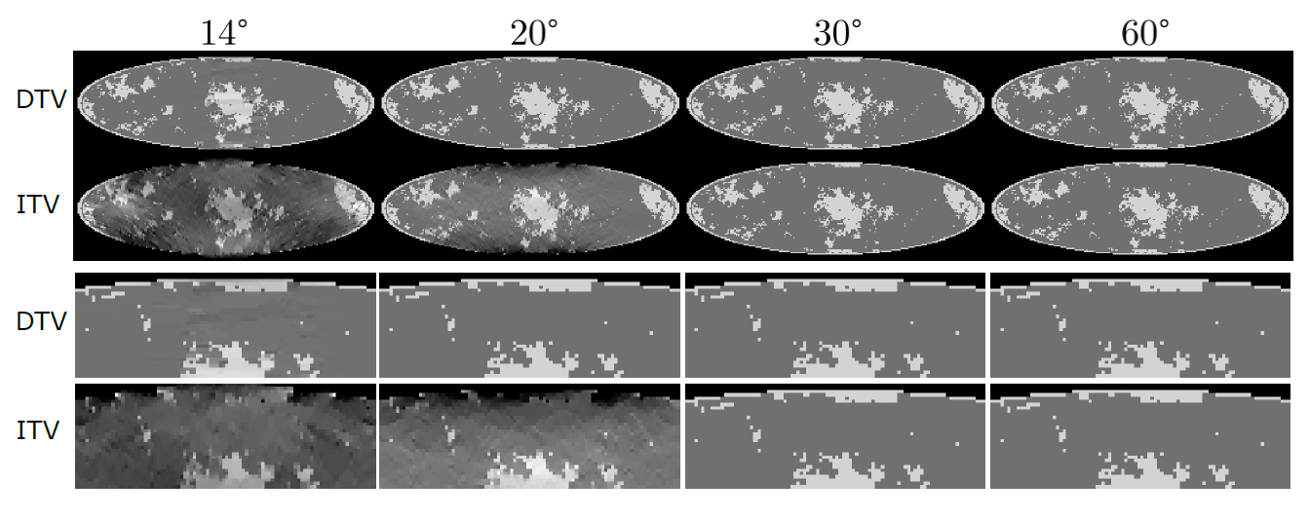
Directional TV reconstruction algorithm for PACT

Slide 15
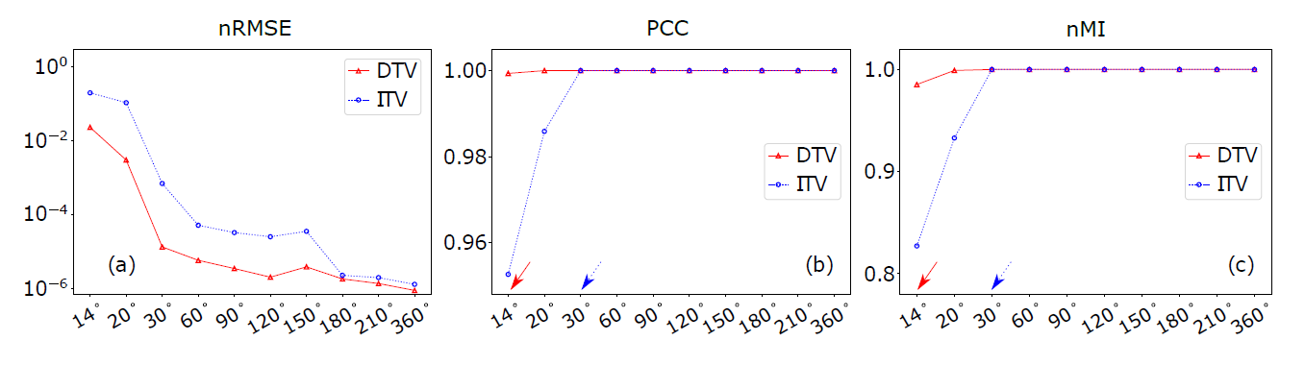
Directional TV reconstruction algorithm for PACT
nRMSE: Normalized root mean-sqoared error
PCC: Pearson correlation coefficient
nMI: normalized mutual information

Slide 16
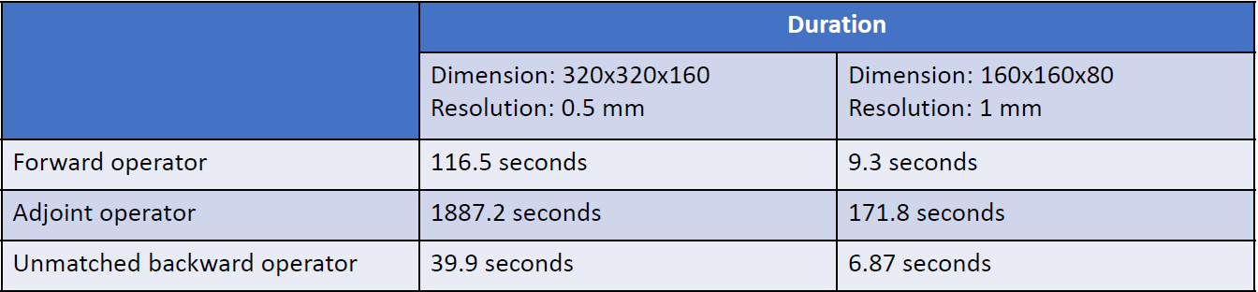
Difficulties that I encountered during DTV project
The problematic part was the time required for the imaging operator especially for the adjoint operator.
Furthermore, we couldn’t use unmatched backward operator to reduce the time, as this optimization algorithm requires the usage of exact adjoint.
Then, by using the k-Wave, we could reduce the required time for 1 iteration of forward and adjoint operator (combined) to 3.5 minutes.
Interpolation based PACT model time measurements of forward and adjoint operators

Slide 17
Dynamic reconstruction of
3D PACT from few projections

Slide 18
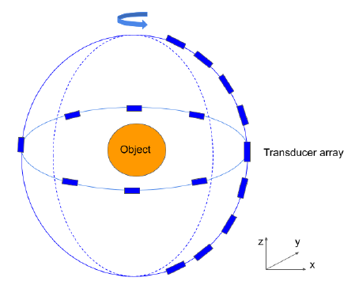
Dynamic reconstruction of 3D PACT from few projections
Duration for:
Each tomographic view: 0.1 s
Complete scan (360 views): 36 s
To achieve a high frame rate, only a limited-angle few-view (even a single-view) acoustic measurements can be collected at each time frame. These sparse incomplete data represent a formidable challenge to obtain sequences of reconstructed images with both high spatial and temporal resolution.
Photosound’s TriTom PACT system

Slide 19
Challenges of dynamic PACT
Compared with static reconstruction that only reconstructs a single image, dynamic reconstruction generates a sequence of 3D images; therefore, it is computationally more burdensome.
The storage required for the dynamic reconstruction is increased by the number of frames.
How to achieve the reconstruction with high resolution in spatial space and temporal space simultaneously.

Slide 20
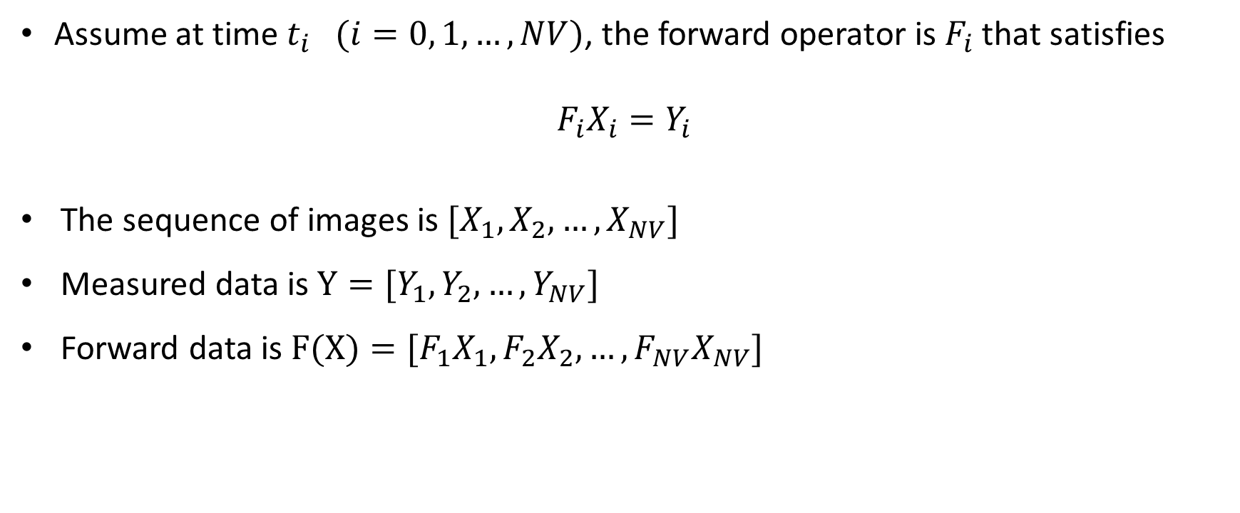
Discrete model of dynamic PACT
Assume at time $t_{i} (i=0, 1, …, NV)$, the forward operator is $F_{i}$ that satisfies
$$F_{i}X_{i}=Y_{i}$$
The sequence of images is $[X_{1}, X_{2}, …, X_{NV}]$
Measured data is $Y=[Y_{1}, Y_{2}, …, Y_{NV}]$
Forward data is $F(X)=[F_{1}X_{1}, F_{2}X_{2}, …,F_{NV}X_{NV}]$

Slide 21
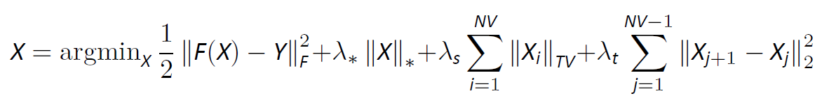
Corresponding optimization problem of dynamic PACT
TV regularization in spatial domain
Nuclear norm regularization:
Imposes low-rank structure
Tight convex surrogate for the rank function
TV regularization in temporal domain

Slide 22
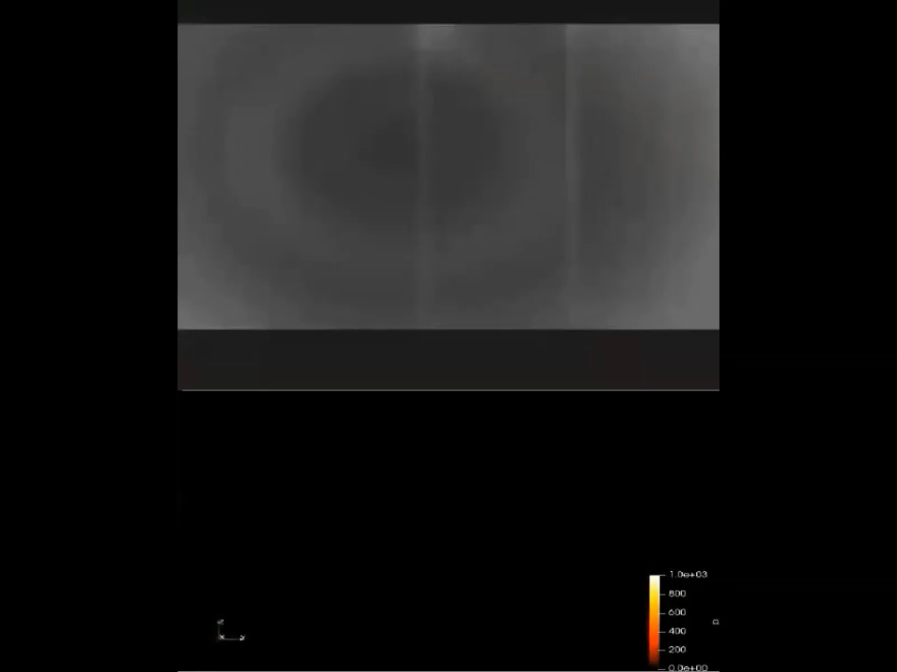
Reconstruction from experimental data
Phantom: two tubes with liquid flowing through
Reconstruction volume: [75,75,75]*0.4 mm
Number of frames: 360
Number of transducers: 96
Video: compare the PACT reconstruction with the video recorded by an optical camera

